Slide 1
KNW 2300 – L01
Wings of Daedalus
Erik Braun, Nathan Hites, Yuhang Liu, Danny Reich, Anthony Wang, Adam Wu

Slide 2
Challenge
Autonomous volcano exploration robot
  Navigation/Pathfinding
  Traversing steep terrain
  Temperature measurement
  Surface water detection
  Sensor deployment
Bridge to traverse fissures
  Optimize load per square unit of mass
  Lightweight

Slide 3
Strategy/Task Prioritization
Based on difficulty vs. points analysis:
Navigation to Hot Spot, Surface Water Region, Volcano
Reach summit
Report beacon angle
Deploy gas sensor
Slope measurement
Temperature measurement
Conductivity measurement
Barrier navigation

Slide 4
Essential Requirements
General Construction
  ¼” Acrylic
  ¼” MDF
  1’ Microrax
Basic Functionality
  Arduino
  12V Battery
  Kill Switch
  Fuse-block
  5V regulator
  2x 3 Amp Fuse
  2x 4 Amp Fuse
  Breadboard

Slide 5
Essential Requirements
Mobility
  2x Motor
  Motor Controller
  Motor Encoder
Beacon Sensing
  IR Receiver
  360 Servo
Bridge
  100x Popsicle Sticks
Probe Manipulation
  2x 180 Servo

Slide 6
Desirable Requirements
Additional Motors
Motor Encoder
Decorative Octopus

Slide 7
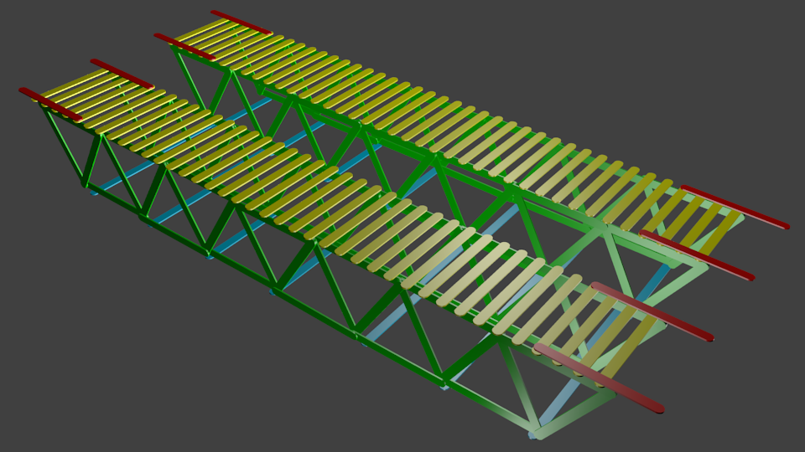
Preliminary Bridge Design
Assumed popsicle stick dimensions: 4.5” x .375” x .0625
Total length: 31.875”
Width: 12.5”
215 Popsicle sticks
Underside support
No cutting
Load-bearing trusses
Struts
Deck
Anchors

Slide 8
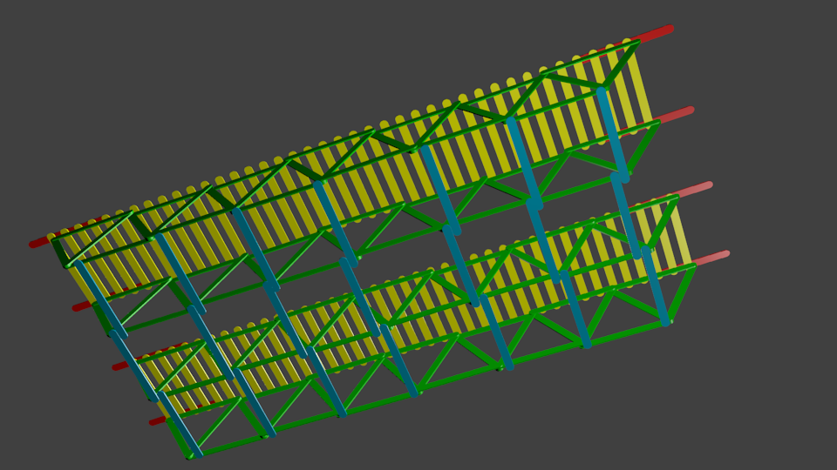
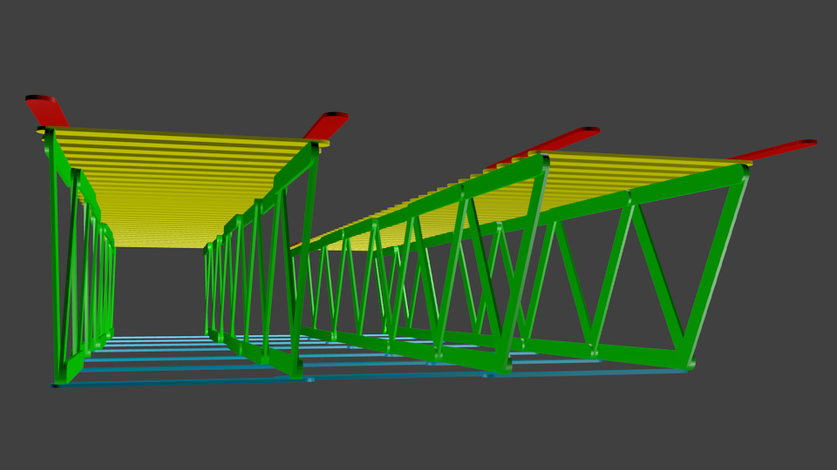
Preliminary Bridge Design
Load-bearing trusses
Struts
Deck
Anchors

Slide 9
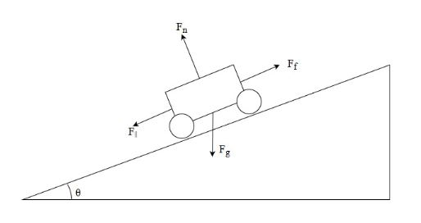
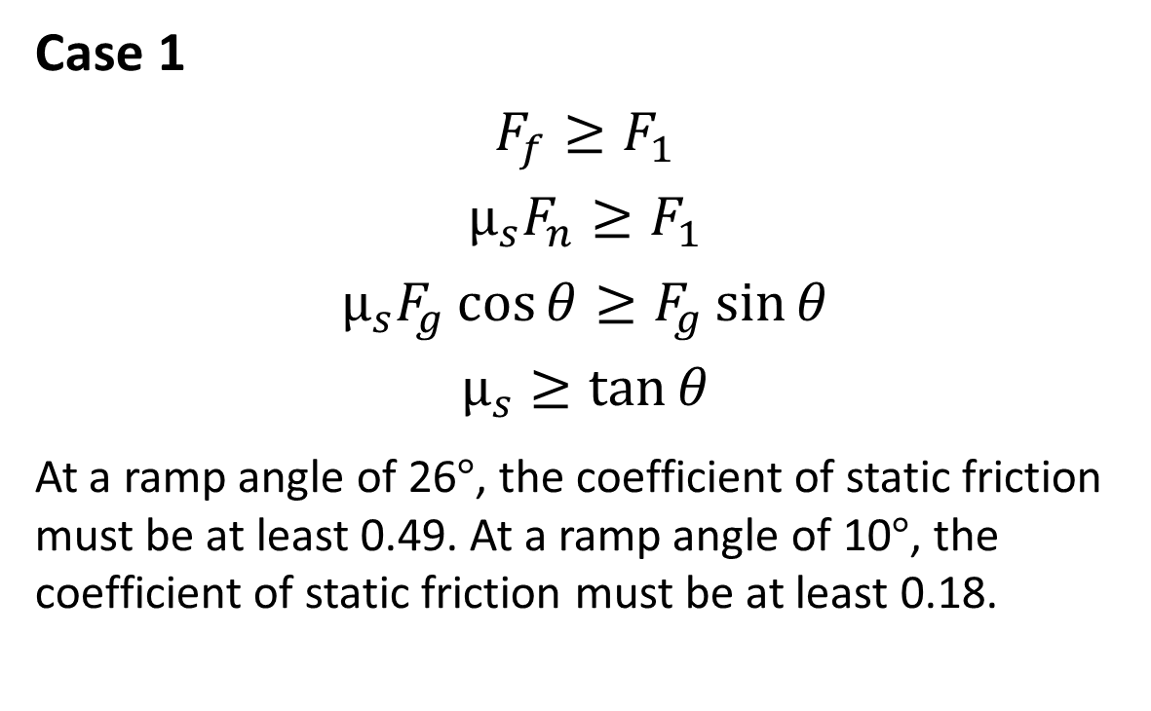
Ramp Physics Calculations
Case 1
$$F_{f}≥F_{1}$$
$$µ_{s}F_{n}≥F_{1}$$
$$µ_{s}F_{g}\cos{θ}≥F_{g}\sin{θ}$$
$$µ_{s}≥\tan{θ}$$
At a ramp angle of 26°, the coefficient of static friction must be at least 0.49. At a ramp angle of 10°, the coefficient of static friction must be at least 0.18.

Slide 10
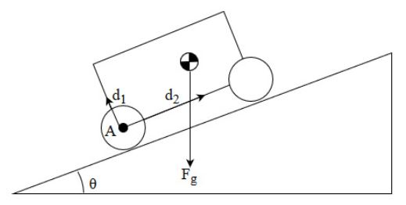

Ramp Physics Calculations
Case 2
The center of mass must lie in front of the rear axle to prevent tipping. Therefore the inverse tangent of d1 and d2 must be greater than theta.
The minimum ratio of d2 to d1 is the
tangent of theta.
$$\tan^{−1}{\frac{d_{2}}{d_{1}}}≥θ$$
$$\frac{d_{2}}{d_{1}}≥\tan{θ}$$

Slide 11
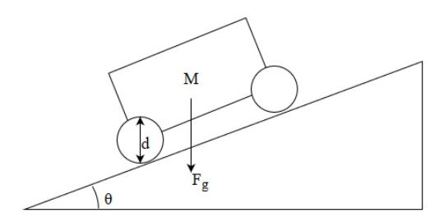
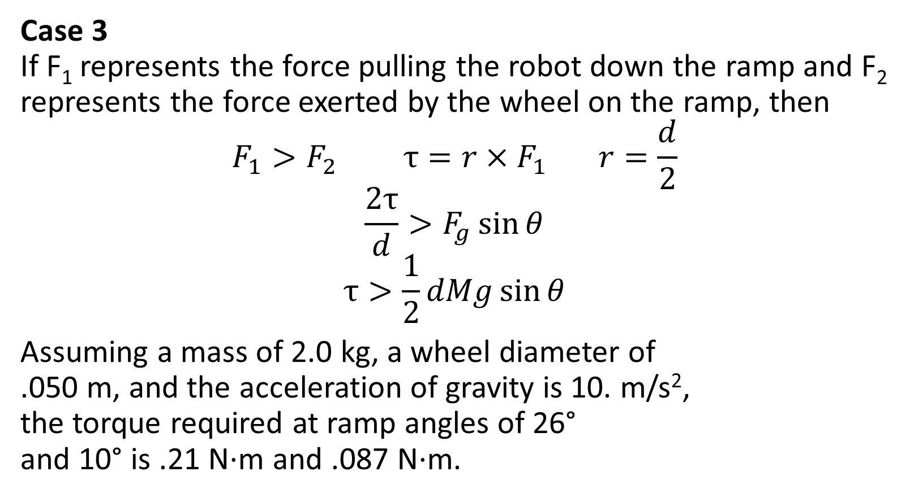
Ramp Physics Calculations
Case 3
If F₁ represents the force pulling the robot down the ramp and F₂ represents the force exerted by the wheel on the ramp, then
$$F_{1}>F_{2} τ=r×F_{1} r=\frac{d}{2}$$
$$\frac{2τ}{d}>F_{g}\sin{θ}$$
$$τ>\frac{1}{2}dMg\sin{θ}$$
Assuming a mass of 2.0 kg, a wheel diameter of
.050 m, and the acceleration of gravity is 10. m/s²,
the torque required at ramp angles of 26°
and 10° is .21 N⋅m and .087 N⋅m.

